Slide 1
Unit 04: Hardware Description Language – Verilog

Slide 2
The Verilog Language
Originally a modeling language for a very efficient event-driven digital logic simulator
Later pushed into use as a specification language for logic synthesis
Now, one of the two most commonly-used languages in digital hardware design (VHDL is the other)
Virtually every chip (FPGA, ASIC, etc.) is designed in part using one of these two languages
Combines structural and behavioral modeling styles

Slide 3

Multiplexer Built From Primitives
Verilog programs built from modules
module mux(f, a, b, sel);
output f;
input a, b, sel;
and g1(f1, a, nsel),
g2(f2, b, sel);
or g3(f, f1, f2);
not g4(nsel, sel);
endmodule
Each module has an interface
Module may contain structure: instances of primitives and other modules
a
f1
nsel
g1
g4
g3
f
b
g2
sel
f2

Slide 4
Multiplexer Built From Primitives
module mux(f, a, b, sel);
output f;
input a, b, sel;
and g1(f1, a, nsel),
g2(f2, b, sel);
or g3(f, f1, f2);
not g4(nsel, sel);
endmodule
Identifiers not explicitly defined default to wires
a
f1
nsel
g1
g4
g3
f
b
g2
sel
f2

Slide 5

Multiplexer Built With Always
module mux(f, a, b, sel);
output f;
input a, b, sel;
reg f;
always @(a or b or sel)
if (sel) f = b;
else f = a;
endmodule
Modules may contain one or more always blocks
Sensitivity list contains signals whose change triggers the execution of the block
a
f
b
sel

Slide 6

Multiplexer Built With Always
module mux(f, a, b, sel);
output f;
input a, b, sel;
reg f;
always @(a or b or sel)
if (sel) f = b;
else f = a;
endmodule
A reg behaves like memory: holds its value until imperatively assigned otherwise
Body of an always block contains traditional imperative code
a
f
b
sel

Slide 7
Mux with Continuous Assignment
module mux(f, a, b, sel);
output f;
input a, b, sel;
assign f = sel ? a : b;
endmodule
LHS is always set to the value on the RHS
Any change on the right causes reevaluation
a
f
b
sel

Slide 8

Mux with User-Defined Primitive
primitive mux(f, a, b, sel);
output f;
input a, b, sel;
table
1?0 : 1;
0?0 : 0;
?11 : 1;
?01 : 0;
11? : 1;
00? : 0;
endtable
endprimitive
Behavior defined using a truth table that includes “don’t cares”
When a & b match, sel is ignored
(others produce X)
a
f
b
sel

Slide 9
How Are Simulators Used?
Testbench generates stimulus and checks response
Coupled to model of the system
Pair is run simultaneously
Testbench
System Model
Stimulus
Response
Result checker

Slide 10
Structural Modeling
When Verilog was first developed (1984) most logic simulators operated on netlists
Netlist: list of gates and how they’re connected
A natural representation of a digital logic circuit
Not the most convenient way to express test benches

Slide 11
Behavioral Modeling
A much easier way to write testbenches
Also good for more abstract models of circuits
  Easier to write
  Simulates faster
More flexible
Provides sequencing
Verilog succeeded in part because it allowed both the model and the testbench to be described together

Slide 12
How Verilog Is Used
Virtually every ASIC is designed using either Verilog or VHDL (a similar language)
Behavioral modeling with some structural elements
“Synthesis subset”
  Can be translated using Synopsys’ Design Compiler or others into a netlist
Design written in Verilog
Simulated to death to check functionality
Synthesized (netlist generated)
Static timing analysis to check timing

Slide 13

Two Main Components of Verilog
Concurrent, event-triggered processes (behavioral)
  Initial and Always blocks
  Imperative code that can perform standard data manipulation tasks (assignment, if-then, case)
  Processes run until they delay for a period of time or wait for a triggering event
Structure
  Verilog program built from modules with I/O interfaces
  Modules may contain instances of other modules
  Modules contain local signals, etc.
  Module configuration is static and all run concurrently

Slide 14

Two Main Data Types
Nets represent connections between things
  Do not hold their value
  Take their value from a driver such as a gate or other module
  Cannot be assigned in an initial or always block
Regs represent data storage
  Behave exactly like memory in a computer
  Hold their value until explicitly assigned in an initial or always block
  Can be used to model latches, flip-flops, etc., but do not correspond exactly

Slide 15
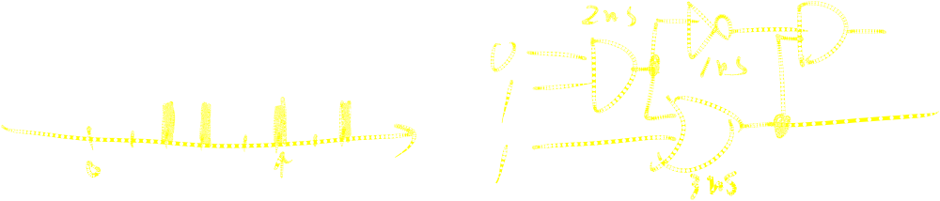
Discrete-event Simulation
Basic idea: only do work when something changes
Centered around an event queue
  Contains events labeled with the simulated time at which they are to be executed
Basic simulation paradigm
  Execute every event for the current simulated time
  Doing this changes system state and may schedule events in the future
  When there are no events left at the current time instance, advance simulated time soonest event in the queue

Slide 16
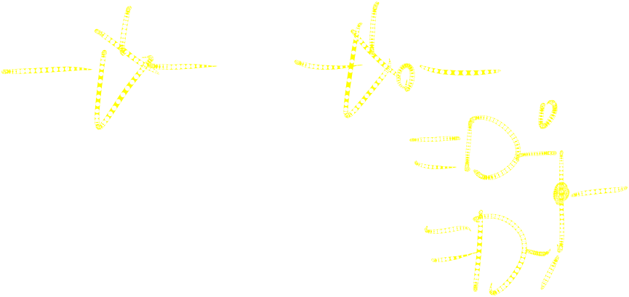
Four-valued Data
Verilog’s nets and registers hold four-valued data
0, 1
  Obvious
Z
  Output of an undriven tri-state driver
  Models case where nothing is setting a wire’s value
X
  Models when the simulator can’t decide the value
  Initial state of registers
  When a wire is being driven to 0 and 1 simultaneously
  Output of a gate with Z inputs

Slide 17

Four-valued Logic
Logical operators work on three-valued logic
0 1 X Z
0 0 0 0 0
1 0 1 X X
X 0 X X X
Z 0 X X X
Output 0 if one input is 0
Output X if both inputs are gibberish

Slide 18
Structural Modeling

Slide 19
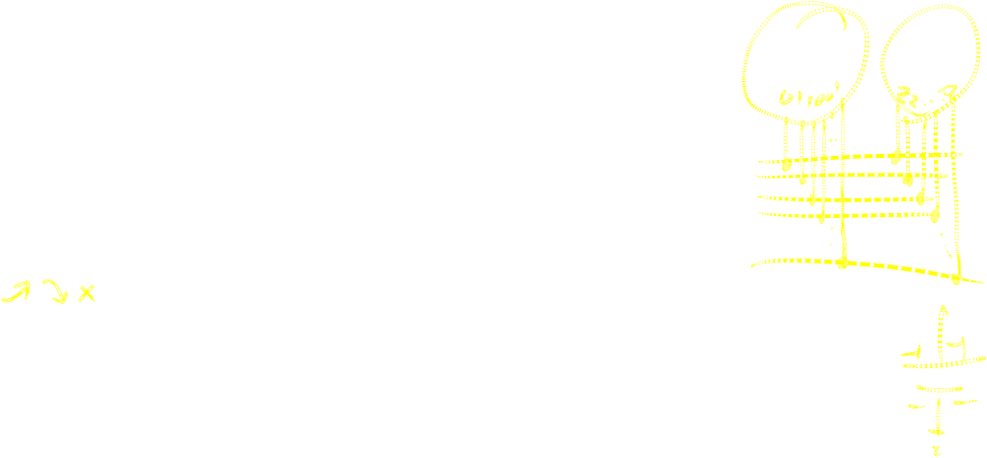
Nets and Registers
Wires and registers can be bits, vectors, and arrays
wire a; // Simple wire
tri [15:0] dbus; // 16-bit tristate bus
tri #(5,4,8) b; // Wire with delay
reg [-1:4] vec; // Six-bit register
trireg (small) q; // Wire stores a small charge
integer imem[0:1023]; // Array of 1024 integers
reg [31:0] dcache[0:63]; // A 32-bit memory

Slide 20
Modules and Instances
Basic structure of a Verilog module:
module mymod(output1, output2, … input1, input2);
output output1;
output [3:0] output2;
input input1;
input [2:0] input2;
…
endmodule
Verilog convention lists outputs first

Slide 21
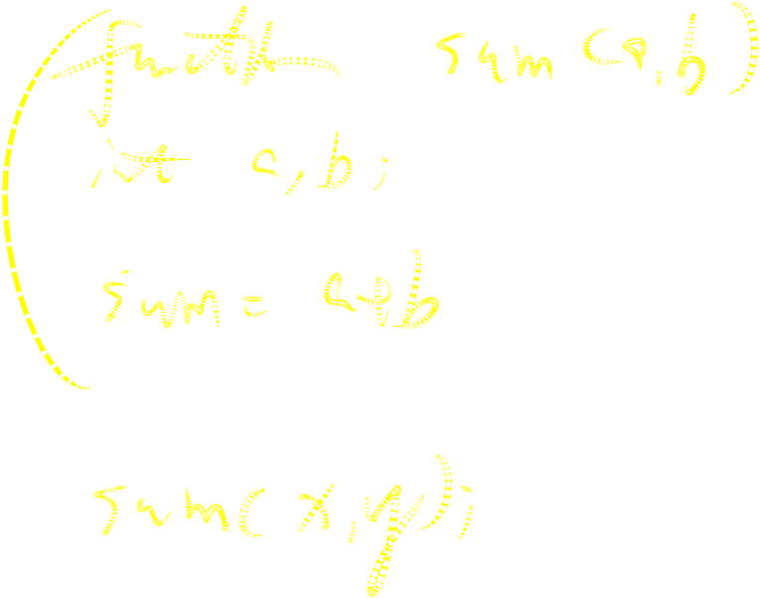
Instantiating a Module
Instances of
module mymod(y, a, b);
look like
mymod mm1(y1, a1, b1); // Connect-by-position
mymod (y2, a1, b1),
(y3, a2, b2); // Instance names omitted

Slide 22
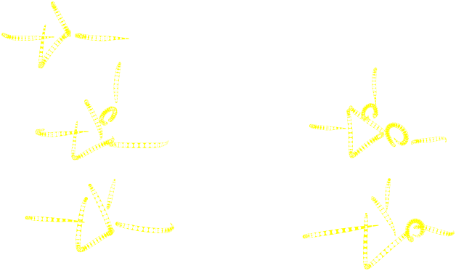
Gate-level Primitives
Verilog provides the following:
and nand logical AND/NAND
or nor logical OR/NOR
xor xnor logical XOR/XNOR
buf not buffer/inverter
bufif0 notif0 Tristate with low enable
bufif1 notif1 Tristate with high enable

Slide 23
Delays on Primitive Instances
Instances of primitives may include delays
buf b1(a, b); // Zero delay
buf #3 b2(c, d); // Delay of 3
buf #(4,5) b3(e, f); // Rise=4, fall=5
buf #(3:4:5) b4(g, h); // Min-typ-max

Slide 24

Switch-level Primitives
Verilog also provides mechanisms for modeling CMOS transistors that behave like switches
A more detailed modeling scheme that can catch some additional electrical problems when transistors are used in this way
Now, little-used because circuits generally aren’t built this way
More seriously, model is not detailed enough to catch many of the problems
These circuits are usually simulated using SPICE-like simulators based on nonlinear differential equation solvers

Slide 25
User-Defined Primitives
Way to define gates and sequential elements using a truth table
Often simulate faster than using expressions, collections of primitive gates, etc.
Most often used for specifying custom gate libraries

Slide 26
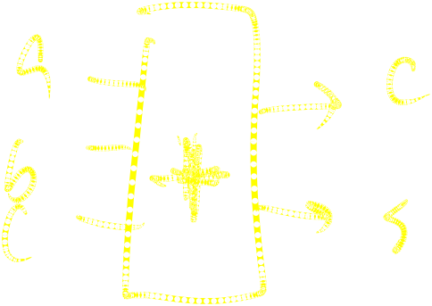
A Carry Primitive
primitive carry(out, a, b, c);
output out;
input a, b, c;
table
00? : 0;
0?0 : 0;
?00 : 0;
11? : 1;
1?1 : 1;
?11 : 1;
endtable
endprimitive
Always have exactly one output
Truth table may include don’t-care (?) entries

Slide 27
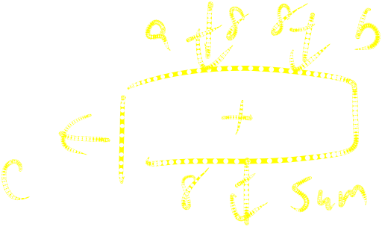
Continuous Assignment
Another way to describe combinational function
Convenient for logical or datapath specifications
wire [8:0] sum;
wire [7:0] a, b;
wire carryin;
assign sum = a + b + carryin;
Define bus widths
Continuous assignment: permanently sets the value of sum to be a+b+carryin
Recomputed when a, b, or carryin changes

Slide 28
Behavioral Modeling

Slide 29
Initial and Always Blocks
Basic components for behavioral modeling
initial
begin
… imperative statements …
end
Runs when simulation starts
Terminates when control reaches the end
Good for providing stimulus
always
begin
… imperative statements …
end
Runs when simulation starts
Restarts when control reaches the end
Good for modeling/specifying hardware

Slide 30
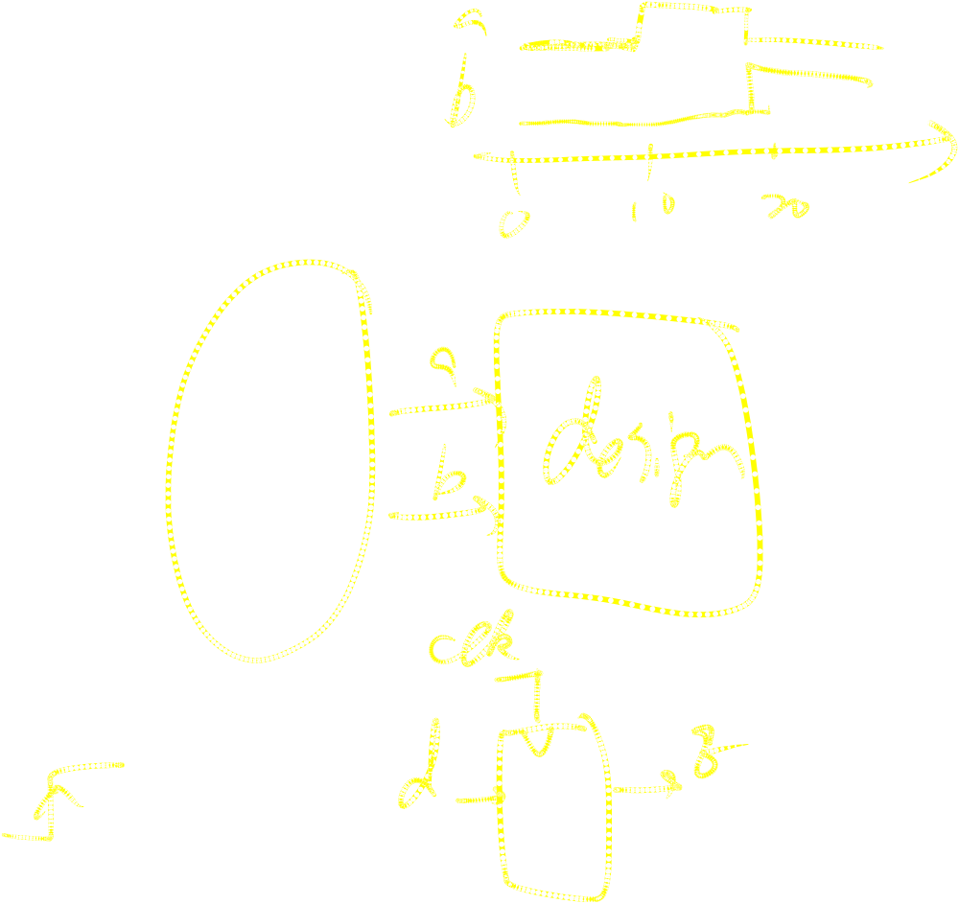
Initial and Always
Run until they encounter a delay
initial begin
#10 a = 1; b = 0;
#10 a = 0; b = 1;
end
or a wait for an event
always @(posedge clk) q = d;
always begin wait(i); a = 0; wait(~i); a = 1; end

Slide 31
Procedural Assignment
Inside an initial or always block:
sum = a + b + cin;
Just like in C: RHS evaluated and assigned to LHS before next statement executes
RHS may contain wires and regs
  Two possible sources for data
LHS must be a reg
  Primitives or cont. assignment may set wire values

Slide 32
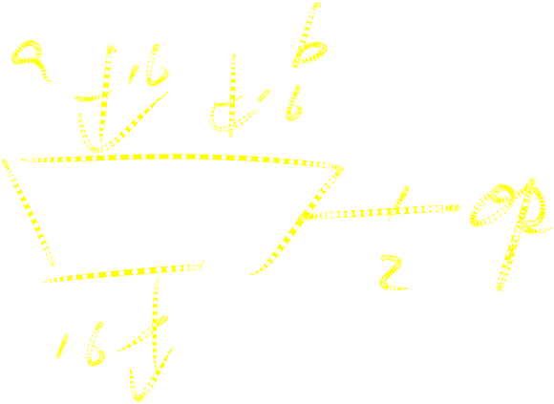
Imperative Statements
if (select == 1) y = a;
else y = b;
case (op)
2’b00: y = a + b;
2’b01: y = a – b;
2’b10: y = a ^ b;
default: y = ‘hxxxx;
endcase

Slide 33

For Loops
A increasing sequence of values on an output
reg [3:0] i, output;
for ( i = 0 ; i <= 15 ; i = i + 1 ) begin
output = i;
#10;
end

Slide 34
While Loops
A increasing sequence of values on an output
reg [3:0] i, output;
i = 0;
while (i <= 15) begin
output = i;
#10 i = i + 1;
end

Slide 35
Modeling A Flip-Flop With Always
Very basic: an edge-sensitive flip-flop
reg q;
always @(posedge clk)
q = d;
q = d assignment runs when clock rises: exactly the behavior you expect

Slide 36
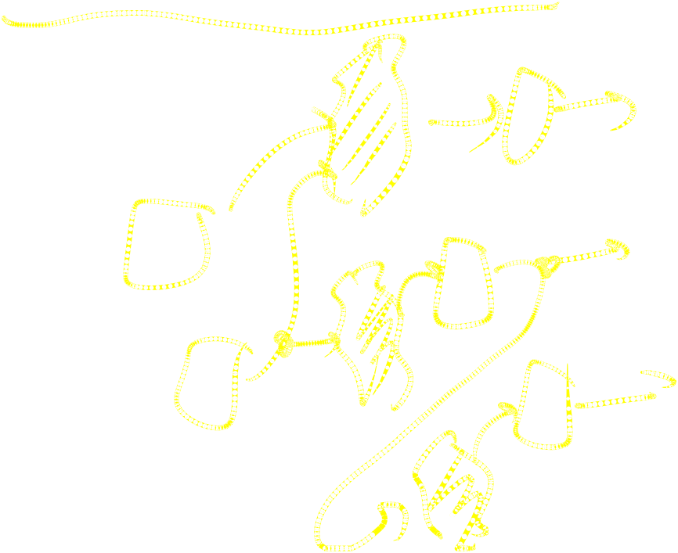
Blocking vs. Nonblocking
Verilog has two types of procedural assignment
Fundamental problem:
  In a synchronous system, all flip-flops sample simultaneously
  In Verilog, always @(posedge clk) blocks run in some undefined sequence

Slide 37
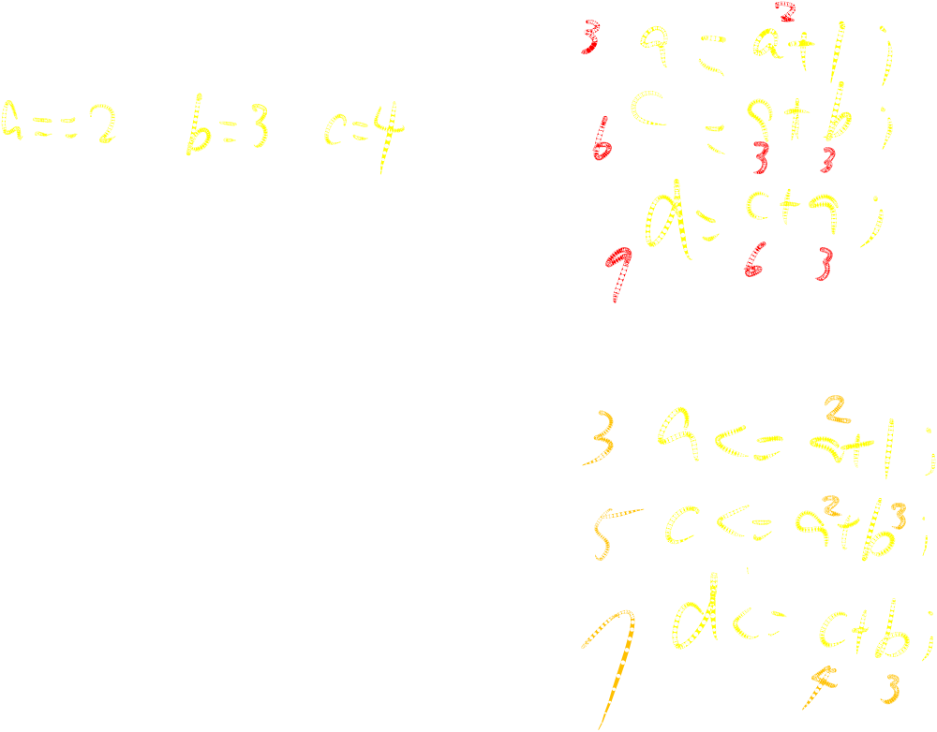
A Flawed Shift Register
This doesn’t work as you’d expect:
reg d1, d2, d3, d4;
always @(posedge clk) d2 = d1;
always @(posedge clk) d3 = d2;
always @(posedge clk) d4 = d3;
These run in some order, but you don’t know which

Slide 38

Non-blocking Assignments
Nonblocking rule:
RHS evaluated when assignment runs
This version does work:
reg d1, d2, d3, d4;
always @(posedge clk) d2 <= d1;
always @(posedge clk) d3 <= d2;
always @(posedge clk) d4 <= d3;
LHS updated only after all events for the current instant have run

Slide 39
Nonblocking Looks Like Latches
RHS of nonblocking taken from latches
RHS of blocking taken from wires
a = 1;
b = a;
c = b;
“
”
a
b
c
1
1
a
a <= 1;
b <= a;
c <= b;
“
”
b
c

Slide 40
Building Behavioral Models

Slide 41
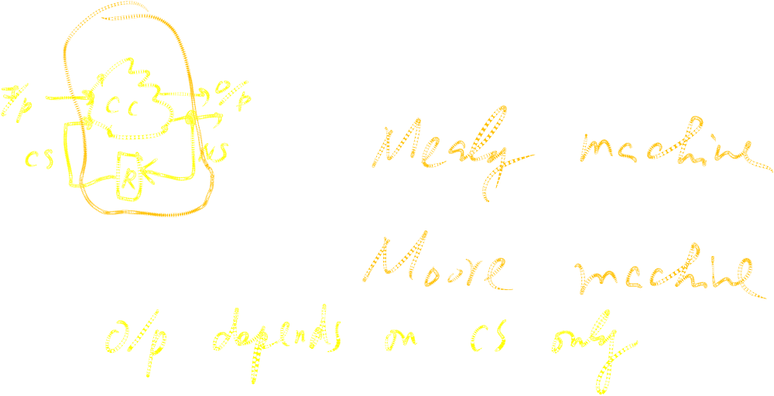
Modeling FSMs Behaviorally
There are many ways to do it:
Define the next-state logic combinationally and define the state-holding latches explicitly
Define the behavior in a single always @(posedge clk) block
Variations on these themes

Slide 42

FSM with Combinational Logic
Output o is declared a reg because it is assigned procedurally, not because it holds state
module FSM(o, a, b, reset);
output o;
reg o;
input a, b, reset;
reg [1:0] state, nextState;
always @(a or b or state)
case (state)
2’b00: begin
nextState = a ? 2’b00 : 2’b01;
o = a & b;
end
2’b01: begin nextState = 2’b10; o = 0; end
endcase
Combinational block must be sensitive to any change on any of its inputs
(Implies state-holding elements otherwise)

Slide 43

FSM with Combinational Logic
module FSM(o, a, b, reset);
…
always @(posedge clk or reset)
if (reset)
state <= 2’b00;
else
state <= nextState;
Latch implied by sensitivity to the clock or reset only

Slide 44
FSM from Combinational Logic
always @(a or b or state)
case (state)
2’b00: begin
nextState = a ? 2’b00 : 2’b01;
o = a & b;
end
2’b01: begin nextState = 2’b10; o = 0; end
endcase
always @(posedge clk or reset)
if (reset)
state <= 2’b00;
else
state <= nextState;
This is a Mealy machine because the output is directly affected by any change on the input

Slide 45
FSM from a Single Always Block
Expresses Moore machine behavior:
Outputs are latched
Inputs only sampled at clock edges
module FSM(o, a, b);
output o; reg o;
input a, b;
reg [1:0] state;
always @(posedge clk or reset)
if (reset) state <= 2’b00;
else case (state)
2’b00: begin
state <= a ? 2’b00 : 2’b01;
o <= a & b;
end
2’b01: begin state <= 2’b10; o <= 0; end
endcase
Nonblocking assignments used throughout to ensure coherency.
RHS refers to values calculated in previous clock cycle

Slide 46
Writing Testbenches
Inputs to device under test
module test;
reg a, b, sel;
mux m(y, a, b, sel);
initial begin
$monitor($time,, “a = %b b=%b sel=%b y=%b”,
a, b, sel, y);
a = 0; b= 0; sel = 0;
#10 a = 1;
#10 sel = 1;
#10 b = 1;
end
Device under test
$monitor is a built-in event driven “printf”
Stimulus generated by sequence of assignments and delays

Slide 47
Simulating Verilog

Slide 48
Simulation Behavior
Scheduled using an event queue
Non-preemptive, no priorities
Events at a particular time unordered
Scheduler runs each event at the current time, possibly scheduling more as a result

Slide 49
Two Types of Events
Evaluation events compute functions of inputs
Update events change outputs
Split necessary for delays, nonblocking assignments, etc.
Evaluation event reads values of b and c, adds them, and schedules an update event
Update event writes new value of a and schedules any evaluation events that are sensitive to a change on a
a <= b + c

Slide 50
Simulation Behavior
Concurrent processes (initial, always) run until they stop at one of the following
#42
  Schedule process to resume 42 time units from now
wait(cf & of)
  Resume when expression “cf & of” becomes true
@(a or b or y)
  Resume when a, b, or y changes
@(posedge clk)
  Resume when clk changes from 0 to 1

Slide 51
Simulation Behavior
Infinite loops are possible and the simulator does not check for them
This runs forever
while (~ready)
count = count + 1;
Instead, use
wait(ready);

Slide 52
Simulation Behavior
Race conditions abound in Verilog
These can execute in either order: final value of a undefined:
always @(posedge clk) a = 0;
always @(posedge clk) a = 1;

Slide 53
Simulation Behavior
Semantics of the language closely tied to simulator implementation
Context switching behavior convenient for simulation, not always best way to model
Undefined execution order convenient for implementing event queue

Slide 54
Compiled-Code Discrete-Event Sim.
Most modern simulators use this approach
Verilog program compiled into C
Each concurrent process (e.g., continuous assignment, always block) becomes one or more C functions
Initial and always blocks split into multiple functions, one per segment of code between a delay, a wait, or event control (@)
Central, dynamic event queue invokes these functions and advances simulation time

Slide 55
Verilog and Logic Synthesis

Slide 56
Logic Synthesis
Verilog is used in two ways
  Model for discrete-event simulation
  Specification for a logic synthesis system
Logic synthesis converts a subset of the Verilog language into an efficient netlist
One of the major breakthroughs in designing logic chips in the last 20 years
Most chips are designed using at least some logic synthesis

Slide 57
Logic Synthesis Tools
Mostly commercial tools
  Very difficult, complicated programs to write well
  Limited market
  Commercial products in $10k - $100k price range
Major vendors
  Synopsys Design Compiler, FPGA Express
  Cadence BuildGates
  Synplicity (FPGAs)
  Exemplar (FPGAs)
Academic tools
  SIS (UC Berkeley)

Slide 58
Logic Synthesis
Takes place in two stages:
Translation of Verilog (or VHDL) source to a netlist
  Register inference
Optimization of the resulting netlist to improve speed and area
  Most critical part of the process
  Algorithms very complicated and beyond the scope of this class

Slide 59
Logic Optimization
Netlist optimization the critical enabling technology
Takes a slow or large netlist and transforms it into one that implements the same function more cheaply
Typical operations
  Constant propagation
  Common subexpression elimination
  Function factoring
Time-consuming operation
  Can take hours for large chips

Slide 60
Translating Verilog into Gates
Parts of the language easy to translate
  Structural descriptions with primitives
    Already a netlist
  Continuous assignment
    Expressions turn into little datapaths
Behavioral statements the bigger challenge

Slide 61
What Can Be Translated
Structural definitions
  Everything
Behavioral blocks
  Depends on sensitivity list
  Only when they have reasonable interpretation as combinational logic, edge, or level-sensitive latches
  Blocks sensitive to both edges of the clock, changes on unrelated signals, changing sensitivity lists, etc. cannot be synthesized
User-defined primitives
  Primitives defined with truth tables
  Some sequential UDPs can’t be translated (not latches or flip-flops)

Slide 62
What Isn’t Translated
Initial blocks
  Used to set up initial state or describe finite testbench stimuli
  Don’t have obvious hardware component
Delays
  May be in the Verilog source, but are simply ignored
A variety of other obscure language features
  In general, things heavily dependent on discrete-event simulation semantics

Slide 63
Register Inference
The main trick
reg does not always equal latch
Rule: Combinational if outputs always depend exclusively on sensitivity list
Sequential if outputs may also depend on previous values

Slide 64
Register Inference
Combinational:
reg y;
always @(a or b or sel)
if (sel) y = b;
else y = a;
Sequential:
reg q;
always @(d or clk)
if (clk) q = d;
Sensitive to changes on all of the variables it reads
Y is always assigned
q only assigned when clk is 1

Slide 65
Register Inference
A common mistake is not completely specifying a case statement
This implies a latch:
always @(a or b)
case ({a, b})
2’b00 : f = 0;
2’b01 : f = 1;
2’b10 : f = 1;
endcase
f is not assigned when {a,b} = 2b’11

Slide 66
Register Inference
The solution is to always have a default case
always @(a or b)
case ({a, b})
2’b00: f = 0;
2’b01: f = 1;
2’b10: f = 1;
default: f = 0;
endcase
f is always assigned

Slide 67
Inferring Latches with Reset
Latches and Flip-flops often have reset inputs
Can be synchronous or asynchronous
Asynchronous positive reset:
always @(posedge clk or posedge reset)
if (reset)
q <= 0;
else q <= d;

Slide 68
Simulation-synthesis Mismatches
Many possible sources of conflict
Synthesis ignores delays (e.g., #10), but simulation behavior can be affected by them
Simulator models X explicitly, synthesis doesn’t
Behaviors resulting from shared-variable-like behavior of regs is not synthesized
  always @(posedge clk) a = 1;
  New value of a may be seen by other @(posedge clk) statements in simulation, never in synthesis

Slide 69
Summary

Slide 70
Summary of Verilog
Systems described hierarchically
  Modules with interfaces
  Modules contain instances of primitives, other modules
  Modules contain initial and always blocks
Based on discrete-event simulation semantics
  Concurrent processes with sensitivity lists
  Scheduler runs parts of these processes in response to changes

Slide 71
Modeling Tools
Switch-level primitives
  CMOS transistors as switches that move around charge
Gate-level primitives
  Boolean logic gates
User-defined primitives
  Gates and sequential elements defined with truth tables
Continuous assignment
  Modeling combinational logic with expressions
Initial and always blocks
  Procedural modeling of behavior

Slide 72
Language Features
Nets (wires) for modeling interconnection
  Non state-holding
  Values set continuously
Regs for behavioral modeling
  Behave exactly like memory for imperative modeling
  Do not always correspond to memory elements in synthesized netlist
Blocking vs. nonblocking assignment
  Blocking behaves like normal “C-like” assignment
  Nonblocking updates later for modeling synchronous behavior

Slide 73
Language Uses
Event-driven simulation
  Event queue containing things to do at particular simulated times
  Evaluate and update events
  Compiled-code event-driven simulation for speed
Logic synthesis
  Translating Verilog (structural and behavioral) into netlists
  Register inference: whether output is always updated
  Logic optimization for cleaning up the result

Slide 74
Little-used Language Features
Switch-level modeling
  Much slower than gate or behavioral-level models
  Insufficient detail for modeling most electrical problems
  Delicate electrical problems simulated with a SPICE-like differential equation simulator
Delays
  Simulating circuits with delays does not improve confidence enough
  Hard to get timing models accurate enough
  Never sure you’ve simulated the worst case
  Static timing analysis has taken its place

Slide 75
Compared to VHDL
Verilog and VHDL are comparable languages
VHDL has a slightly wider scope
  System-level modeling
  Exposes even more discrete-event machinery
VHDL is better-behaved
  Fewer sources of nondeterminism (e.g., no shared variables)
VHDL is harder to simulate quickly
VHDL has fewer built-in facilities for hardware modeling
VHDL is a much more verbose language
  Most examples don’t fit on slides

Slide 76
In Conclusion
Verilog is a deeply flawed language
  Nondeterministic
  Often weird behavior due to discrete-event semantics
  Vaguely defined synthesis subset
  Many possible sources of simulation/synthesis mismatch
Verilog is widely used because it solves a problem
  Good simulation speed that continues to improve
  Designers use a well-behaved subset of the language
  Makes a reasonable specification language for logic synthesis
  Logic synthesis one of the great design automation success stories

